Slide 1
Java AWT (Abstract Windowing Toolkit)

Slide 2
Java AWT (Abstract Windowing Toolkit) is an API to develop GUI or window-based application in java.
Java AWT components are platform-dependent i.e. components are displayed according to the view of operating system. AWT is heavyweight i.e. its components uses the resources of system.
The java.awt package provides classes for AWT api such as TextField, Label, TextArea, RadioButton, CheckBox, Choice, List etc.

Slide 3
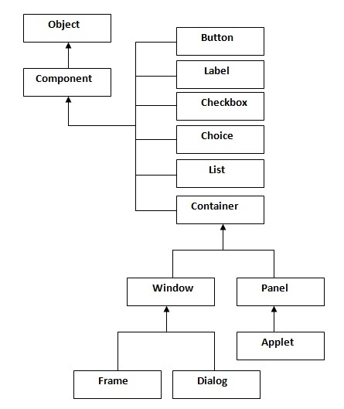
Java AWT Hierarchy The hierarchy of Java AWT classes are given below

Slide 4
Container
The Container is a component in AWT that can contain another components like buttons, textfields, labels etc. The classes that extends Container class are known as container such as Frame, Dialog and Panel.
Window
The window is the container that have no borders and menu bars. You must use frame, dialog or another window for creating a window.
Panel
The Panel is the container that doesn't contain title bar and menu bars. It can have other components like button, textfield etc.
Frame
The Frame is the container that contain title bar and can have menu bars. It can have other components like button, textfield etc.

Slide 5
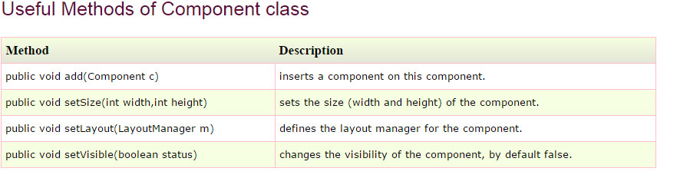

Slide 6
Event and Listener (Java Event Handling)
Changing the state of an object is known as an event. For example, click on button, dragging mouse etc. The java.awt.event package provides many event classes and Listener interfaces for event handling.

Slide 7
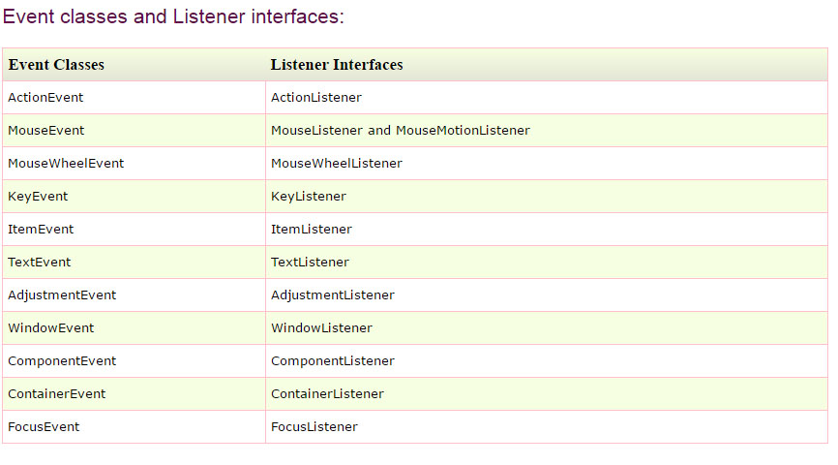

Slide 8
Steps to perform Event Handling
Following steps are required to perform event handling:
1) Implement the Listener interface and overrides its methods
2) Register the component with the Listener
For registering the component with the Listener, many classes provide the registration methods. For example:
Button
public void addActionListener(ActionListener a){}
MenuItem
public void addActionListener(ActionListener a){}
TextField
public void addActionListener(ActionListener a){}
public void addTextListener(TextListener a){}
TextArea
public void addTextListener(TextListener a){}
Checkbox
public void addItemListener(ItemListener a){}
Choice
public void addItemListener(ItemListener a){}
List
public void addActionListener(ActionListener a){}
public void addItemListener(ItemListener a){}

Slide 9
AWT Event Listener
AWT Event Listener Interfaces:
Following is the list of commonly used event listeners.
1 ActionListener
This interface is used for receiving the action events.
2 ComponentListener
This interface is used for receiving the component events.
3 ItemListener
This interface is used for receiving the item events.
4 KeyListener
This interface is used for receiving the key events.
5 MouseListener
This interface is used for receiving the mouse events.
6 TextListener
This interface is used for receiving the text events.

Slide 10
7 WindowListener
This interface is used for receiving the window events.
8 AdjustmentListener
This interface is used for receiving the adjusmtent events.
9 ContainerListener
This interface is used for receiving the container events.
10 MouseMotionListener
This interface is used for receiving the mouse motion events.
11 FocusListener
This interface is used for receiving the focus events.

Slide 11
ActionListener
The class which processes the ActionEvent should implement this interface.The object of that class must be registered with a component. The object can be registered using the addActionListener() method. When the action event occurs, that object's actionPerformed method is invoked.
Interface methods
void actionPerformed(ActionEvent e)
Invoked when an action occurs.

Slide 12
WindowListener
The class which processes the WindowEvent should implement this interface.The object of that class must be registered with a component. The object can be registered using the addWindowListener() method.

Slide 13
Interface Method
void windowActivated(WindowEvent e)
Invoked when the Window is set to be the active Window.
void windowClosed(WindowEvent e)
Invoked when a window has been closed as the result of calling dispose on the window.
void windowClosing(WindowEvent e)
Invoked when the user attempts to close the window from the window's system menu.
void windowDeactivated(WindowEvent e)
Invoked when a Window is no longer the active Window.
void windowDeiconified(WindowEvent e)
Invoked when a window is changed from a minimized to a normal state.
void windowIconified(WindowEvent e)
Invoked when a window is changed from a normal to a minimized state.
void windowOpened(WindowEvent e)
Invoked the first time a window is made visible.

Slide 14
Mouse Listener
The class which processes the MouseEvent should implement this interface.The object of that class must be registered with a component. The object can be registered using the addMouseListener() method.
void mouseClicked(MouseEvent e)
Invoked when the mouse button has been clicked (pressed and released) on a component.
void mouseEntered(MouseEvent e)
Invoked when the mouse enters a component.
void mouseExited(MouseEvent e)
Invoked when the mouse exits a component.
void mousePressed(MouseEvent e)
Invoked when a mouse button has been pressed on a component.
void mouseReleased(MouseEvent e)
Invoked when a mouse button has been released on a component.

Slide 15
MouseMotionListener
The interface MouseMotionListener is used for receiving mouse motion events on a component. The class that process mouse motion events needs to implements this interface.
void mouseDragged(MouseEvent e)
Invoked when a mouse button is pressed on a component and then dragged.
void mouseMoved(MouseEvent e)
Invoked when the mouse cursor has been moved onto a component but no buttons have been pushed.

Slide 16
ItemListener
The class which processes the ItemEvent should implement this interface. The object of that class must be registered with a component. The object can be registered using the addItemListener() method. When the action event occurs, that object's itemStateChanged method is invoked.
void itemStateChanged(ItemEvent e)
Invoked when an item has been selected or deselected by the user.

Slide 17
KeyListener
The class which processes the KeyEvent should implement this interface.The object of that class must be registered with a component. The object can be registered using the addKeyListener() method.

Slide 18
void keyPressed(KeyEvent e)
Invoked when a key has been pressed.
void keyReleased(KeyEvent e)
Invoked when a key has been released.
void keyTyped(KeyEvent e)
Invoked when a key has been typed.

Slide 19
FocusListener
The interface FocusListener is used for receiving keyboard focus events. The class that process focus events needs to implements this interface.
void focusGained(FocusEvent e)
Invoked when a component gains the keyboard focus.
void focusLost(FocusEvent e)
Invoked when a component loses the keyboard focus.

Slide 20
Adapter Classes
Adapters are abstract classes for receiving various events. The methods in these classes are empty. These classes exists as convenience for creating listener objects.

Slide 21
FocusAdapter
An abstract adapter class for receiving focus events.
KeyAdapter
An abstract adapter class for receiving key events.
MouseAdapter
An abstract adapter class for receiving mouse events.
MouseMotionAdapter
An abstract adapter class for receiving mouse motion events.
WindowAdapter
An abstract adapter class for receiving window events.

